Slide 1
Factors Affecting Customer Decision. Sentiment Analysis using Flipkart Product review data.
By,
Manish Kumar
Asif Hussain
Amit Kumar Yadav

Slide 2
TABLE OF CONTENT
Introduction………………………………………….. | 3
Research Objectives………………………………. | 5
Methodology………………………………………... | 6
Business Understanding………………………… | 7
Data Understanding………………………………. | 10
Description Of Datset……………………………. | 11
Data Preparation…………………………………… | 12
Modeling………………………………………………. | 14
Comparison Of Rating Distribution………… | 19
Results & Findings…………………………………. | 21
Conclusion…………………………………………….. | 23

Slide 3
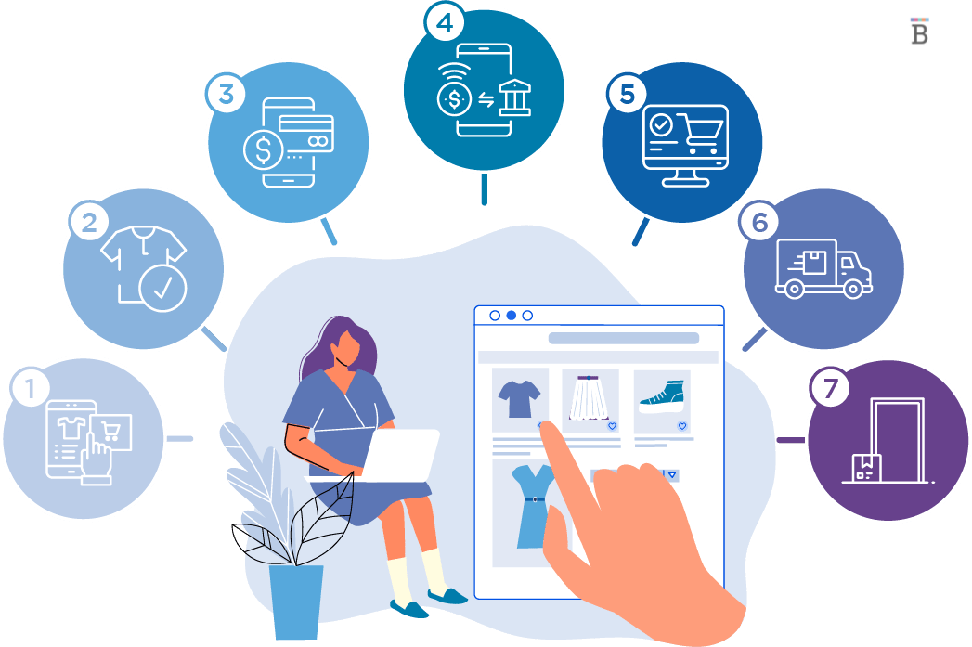
INTRODUCTION
E-Commerce
E – Commerce is an Electronic Marketing Service.
Buying or Selling Products over Electronic Systems or Computer Systems through Internet.
Benefits of E-Commerce
Increased Market Reach.
Cost Efficiency.
Enhanced Customer Experience.
Challenges in E-commerce
Fake Reviews and Inaccurate Ratings.
Discrepancies between Reviews and Ratings.

Slide 4

Relevance of the Project
Reduce Discrepancies:
The project aims to address the challenge of discrepancies between reviews and ratings in e-commerce.
Accurate Customer Reviews:
By leveraging sentiment analysis on customer reviews, we aim to provide a more reliable assessment of customer sentiment.
Benefits of Resolving Discrepancies
Enhancing Customer Trust:
By reducing inconsistencies, customers can trust the authenticity of reviews, leading to informed decision-making.
Improved Buying Experience:
Accurate reviews help customers make confident choices and select products that align with their preferences.

Slide 5

Research Objectives
Collecting Dataset of Customer Reviews and Ratings from Flipkart by Web scraping
Apply sentiment analysis techniques on the dataset
Predict rating of products based on the analysis of the reviews
Compare predicted ratings with actual rating to evaluate the accuracy.
Why choose Flipkart?
Most Famous E-commerce in India
Wide Range of Products
Large Customer Base
Trusted Platform in india
Easy to collect information such as reviews and ratings from the product page.

Slide 6
METHODOLOGY
CRISP-DM Methodology
By adopting the CRISP-DM methodology, this project ensures a structured and systematic approach to predict ratings, and enhance the understanding of customer satisfaction in the e-commerce domain.
The Six phases of the process are:
• Business Understanding : Determine the Business Objectives.
• Data Understanding : Collecting required Data.
• Data Preparation : Selection and Setting up the data for Modeling.
• Modeling : Selection of Modeling technique and Building the Model.
• Evaluation : Evaluating and review the Result and Determine next steps.
• Deployment : Produce final Report and Model Deployment.

Slide 7
Business Understanding
Business Understanding Phase Involves understanding project objectives, requirements, and constraints, identifying business problems or opportunities, and determining how data mining can support organizational goals.
Product review and rating serves as a crucial element in the decision-making process for customers.
In Present Review system, Customers have the freedom to provide reviews and ratings based on their preferences.
No Connection Between Review and Rating.
This project aims to establish a close connection between the review information and the assigned rating.

Slide 8
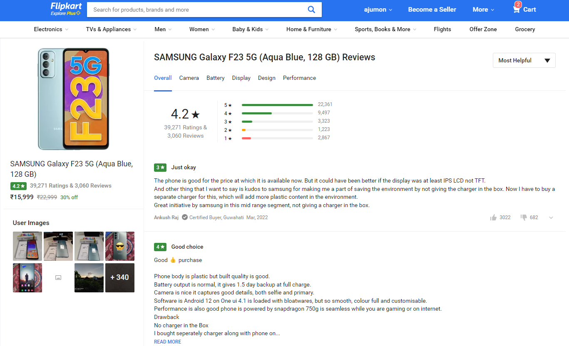
Flipkart Product Review System
Customer Access to Reviews and Ratings:
Customers can easily access product reviews and ratings from the product page.
Rating Scale:
Ratings are based on a scale of 1 to 5.
Customer-Generated Reviews and Ratings:
Reviews and ratings are provided by customers who have purchased the product.
Key Decision-Making Platform:
The product review and rating page is a crucial decision-making platform for customers.
Impact of Ratings and Reviews:
Customers heavily rely on ratings and positive reviews when making purchasing decisions; low ratings or negative reviews can deter customers from buying the product.

Slide 9
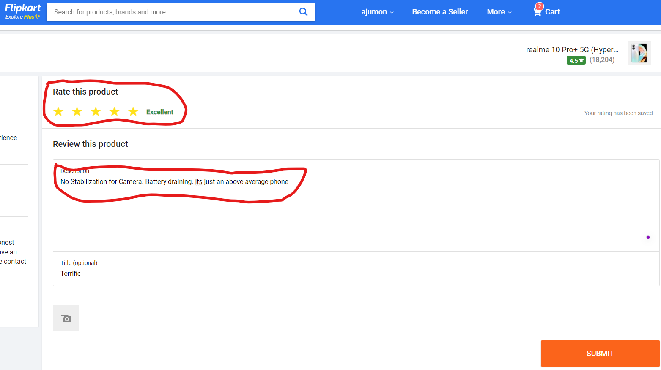
A Customer can submit their rating and review of the product after buying product from Flipkart.
Here, the review and rating are independent, Reviewer can decide the rating and review.
Figure shows an example image of Flipkart Product Review Submission Page.
Our goal is to examine these customer evaluations and determine the rating based on the information they actually provide.

Slide 10
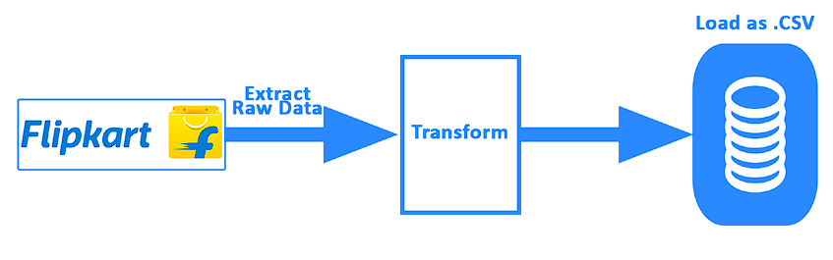
Data Understanding
The primary purpose of the data Understanding phase is to guarantee that the data is appropriate and sufficient for the succeeding modeling phases.
In this project, ETL (Extract, Transform, Load) process is used in this phase to mine the data from flipkart.
The ETL Process has 3 phases
Extraction:
Extracting the data from the website.
Transform:
Selecting important data from the row data
Load:
Load the transformed dataset as csv file for further analysis.

Slide 11
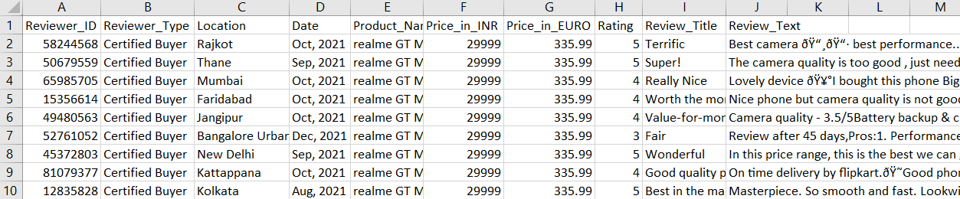
Description Of The Dataset
Entity | Description
Reviewer_ID | 8 Digit Unique ID of Customer
Reviewer_Location | Customer’s Location
Date | Review Date
Product_Name | Name of the Product
Price_in_INR | Price of the product in Indian Rupee
Price_in_Euro | Price of the product in Euro
Rating | Rating of the product (Out of 5)
Review_Title | Title of the Review
Review_Text | Customer Review of the product

Slide 12
Data Preparation
The primary focus of Data Preparation phase will be on cleansing the data to assure that it's suitable for analysis.
Step 1: Reading row dataset and selecting important features for the analysis
Step 2: Clean the review by converting all words to lower case and removing symbols from the data.
Step 3: Removing Stop words such as “a, above, have, then etc..” from the data.
Step 4: Removing repeating characters and numeric numbers.
Step 5: Removing URLs from the data.
After these cleansing process, we get a dataset that is suitable for the analysis.

Slide 13
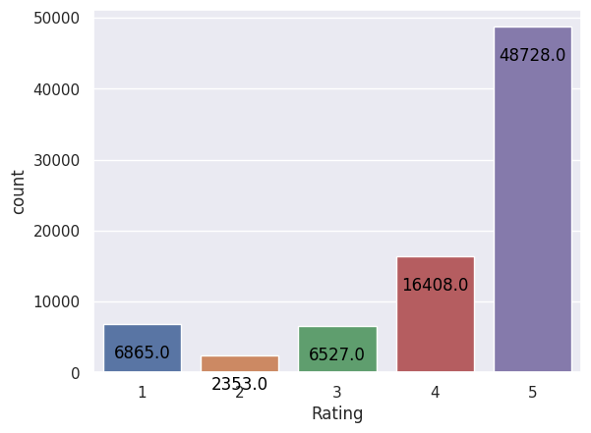
The Dataset have a total of 80,881 rows. This implies that we possess a grand total of 80,881 reviews within our dataset.
Rating Distribution Chart:
Rating 5 = 48728
Rating 4 = 16408
Rating 3 = 6527
Rating 2 = 2353
Rating 1 = 6865
Notes:
Reference: https://www.altexsoft.com/blog/data-pipeline-components-and-types/

Slide 14
Modeling
The fourth phase of the CRISP-DM process involves selecting and applying various modeling techniques to address a data mining problem.
VADER Sentiment Analyzer
VADER Stands for Valence Aware Dictionary for Sentiment Reasoning.
It is a “NLTK”(Natural Language Toolkit) Module.
VADER Provides a sentiment score between “-1 and 1” based on the words used.
-1 means, negative and +1 means positive.
Based on the score, we can also classify the sentiment of the sentences like “positive”, “neutral” or “ negative” etc..

Slide 15
The table below illustrates the conversion of VADER scores, ranging from -1 to +1, to Flipkart ratings on a scale of 1 to 5.
VADER Score Range | Flipkart Rating
Between -1.0 and -0.6 | Rating 1
Between -0.6 and -0.2 | Rating 2
Between -0.2 and +0.2 | Rating 3
Between +0.2 and +0.6 | Rating 4
Between +0.6 and +1.0 | Rating 5

Slide 16
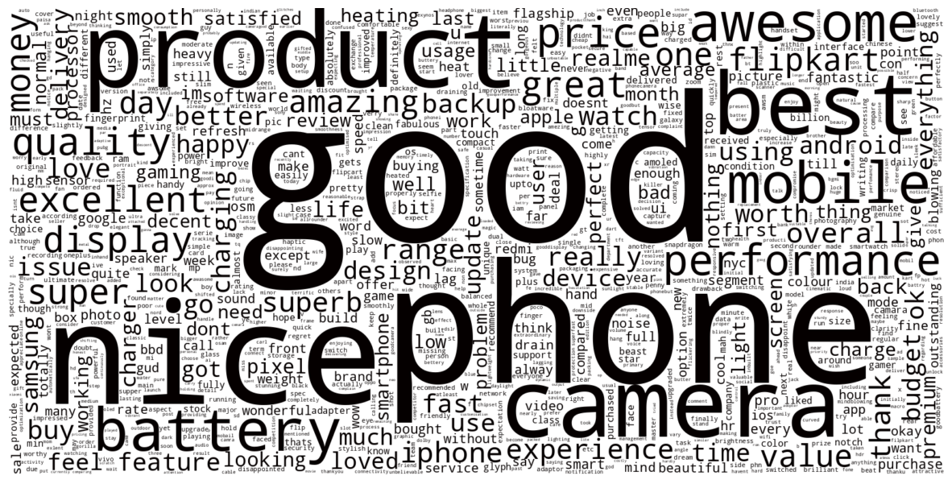
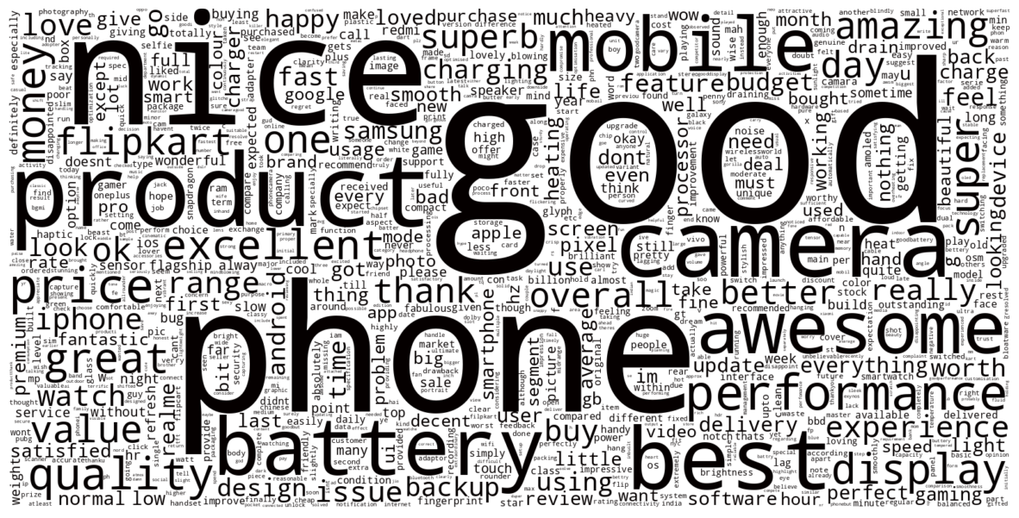
Word cloud – Positive Review
Word cloud of positive review using Customer Rating Sentiment
Word cloud of positive review using Predicted Rating Sentiment
Notes:
Reference: https://www.altexsoft.com/blog/data-pipeline-components-and-types/

Slide 17
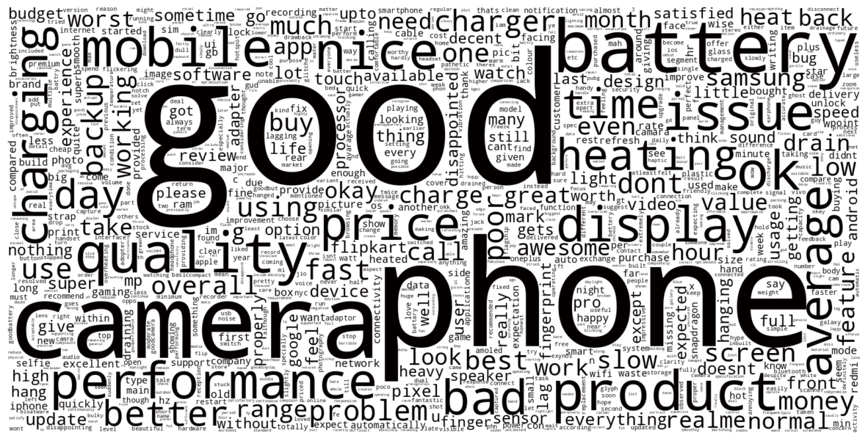
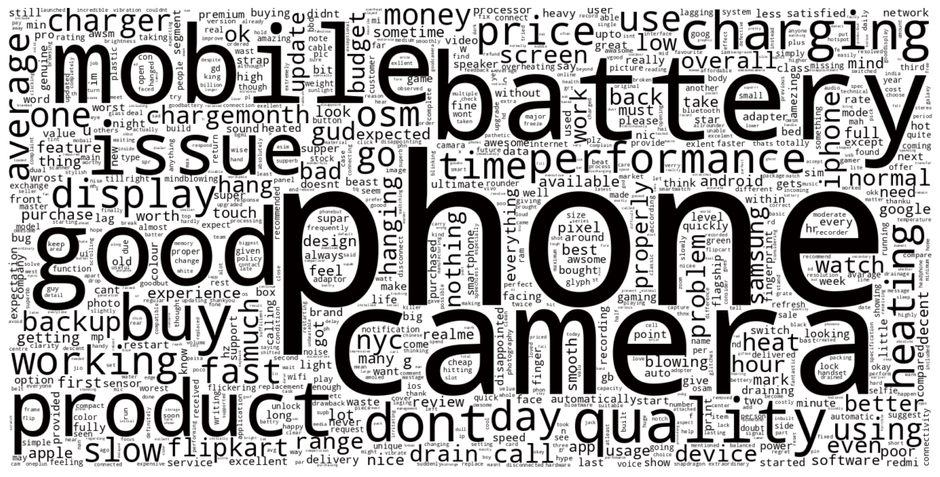
Word cloud – Average Review
Word cloud of average review using Customer Rating Sentiment
Word cloud of average review using Predicted Rating Sentiment
Notes:
Reference: https://www.altexsoft.com/blog/data-pipeline-components-and-types/

Slide 18
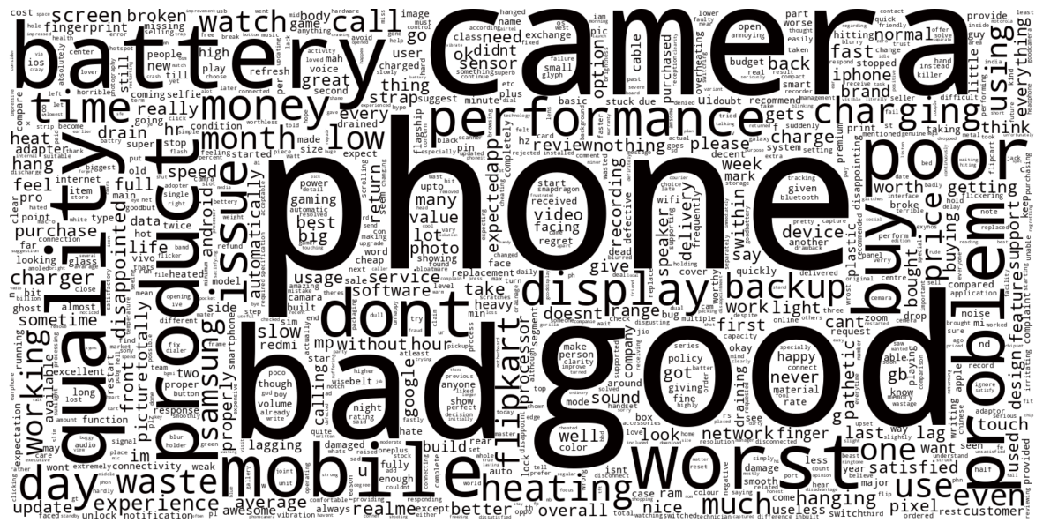
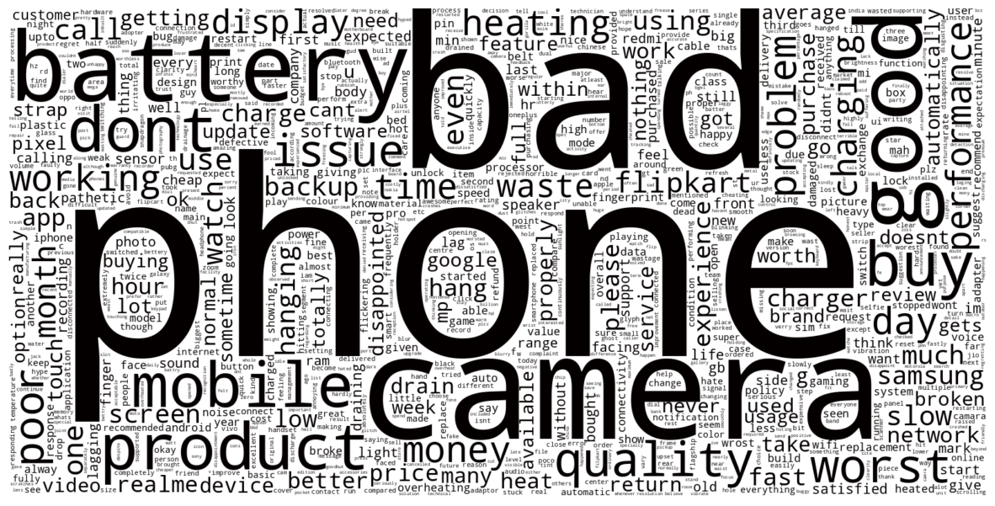
Word cloud – Negative Review
Word cloud of negative review using Customer Rating Sentiment
Word cloud of negative review using Predicted Rating Sentiment
Notes:
Reference: https://www.altexsoft.com/blog/data-pipeline-components-and-types/

Slide 19
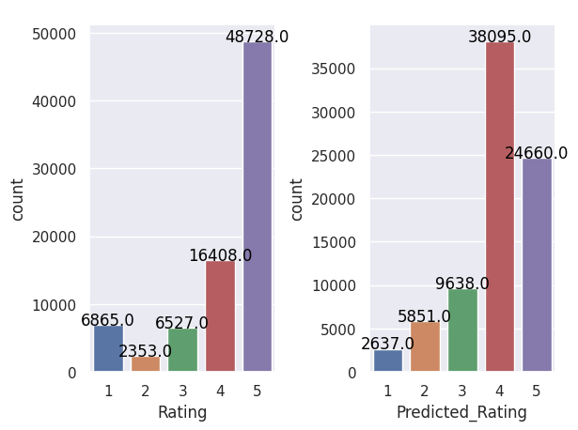
Comparison of Rating Distribution
Rating | Before Analysis | After Analysis
5 | 48728 | 24660
4 | 16408 | 38095
3 | 6527 | 9638
2 | 2353 | 5851
1 | 6865 | 2637
Notes:
Reference: https://www.altexsoft.com/blog/data-pipeline-components-and-types/

Slide 20
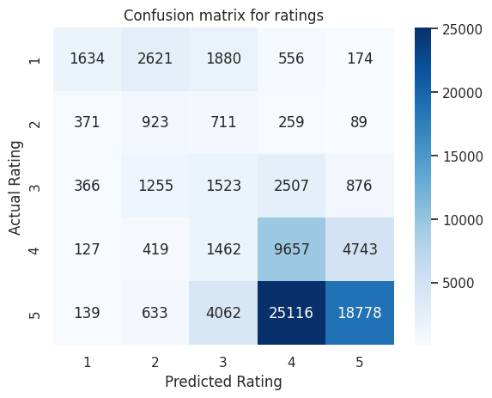
Confusion Matrix for Ratings
Notes:
Reference: https://www.altexsoft.com/blog/data-pipeline-components-and-types/

Slide 21
RESULTS & FINDINGS
Total Number of Reviews : 80881
Original Average Rating : 4.21/5
Predicted Average Rating : 3.94/5
Accuracy of Individual Ratings:
Rating 5 : 56%
Rating 4 : 56%
Rating 3 : 84%
Rating 2 : 91%
Rating 1 : 91%
Overall Rating Accuracy : 40%
Notes:
Reference: https://www.altexsoft.com/blog/data-pipeline-components-and-types/

Slide 22
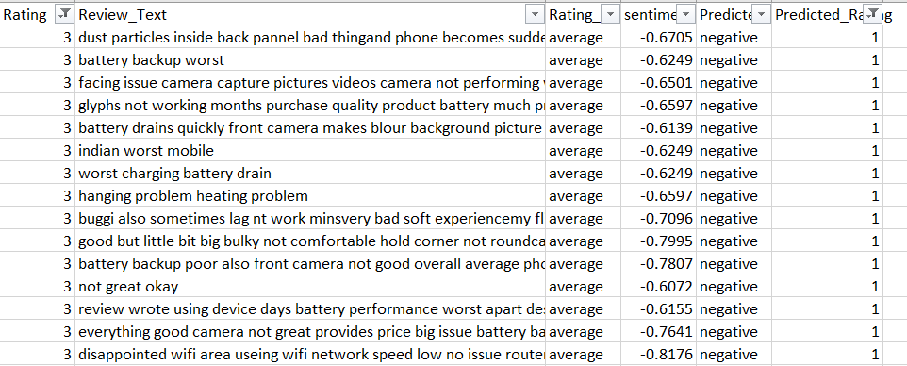
RESULTS & FINDINGS
Flipkart review dataset with real and predicted rating for comparison
Generated new Rating using the sentiment of the Review using VADER Sentiment Analyzer.
Found huge difference in the rating of the product before and after analysis.
The overall rating of the product is changed from 4.21 to 3.94 out of 5.
Implementing this method will provide reliable and accurate rating compared to conventional system.
Notes:
Reference: https://www.altexsoft.com/blog/data-pipeline-components-and-types/

Slide 23
CONCLUSION
This research project utilized VADER Sentiment Analyzer as a valuable tool for sentiment analysis. By considering full words, phrases, and sentences, VADER provided precise sentiment scores that were used to convert them into actual ratings. The project findings revealed a significant disconnect between the current product rating system and the actual sentiments expressed in customer reviews. This highlights the need for a more reliable and accurate rating system, as customers heavily rely on ratings when making purchasing decisions.

